Slide 1

Factors affecting GDP of a country
September, 2022
By- Data analytics student

Slide 2

Agenda
To provide positive and negative factors on a country sustainable GDP Growth.

Slide 3
Solution
By analysing data from 2000 to 2012 year of 207 counties to rate/Correlate different factor against GDP.
After correlating the data to GDP the result is presented using scatter plot/graph for better understanding.

Slide 4
Data used
GDP/capita
Health expenditure /capita
Lending interest
Energy usage/capita
CO² emissions/capita
Birth rate
Infant mortality rate
Life expectancy
Population 0-14
Population 15-64
Population 65+
Population total
Tourism inbound
Tourism outbound/capita
Business tax rate
Days to start business
Ease of business
Hours to do tax
Internet usage
Mobile phone usage

Slide 5

Executive summary / Results
Let’s dive in

Slide 6
Growth affecting sectors
The factors that influence positive growth of GDP of a country are :
The factors that influence negative growth of GDP of a country are :
Health expenditure per person
Internet usage
Tourism going out of country.
Mobile phone usage
Energy utilization per person
Carbon footprint
Tourism going inside of the country
Population of 65+ years of age, increasing life expectancy
Highest correlation
Infant mortality rate
Birth rate
The above points indicate population control should be implemented
Lowest correlation
*Supporting graphs & correlation number & scatter plot are attached as annexure in upcoming slides
**Data with less than or equal to 0.2 correlation factor not included

Slide 7
Annexures (Scatter plots)

Slide 8
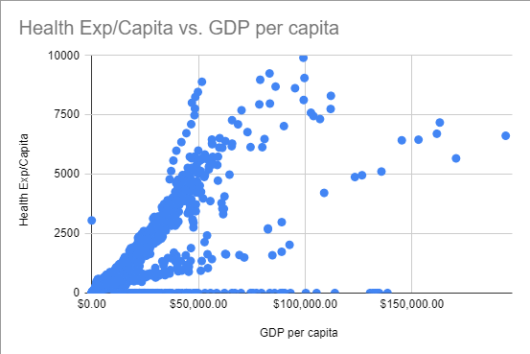
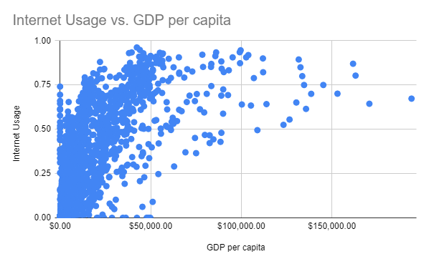
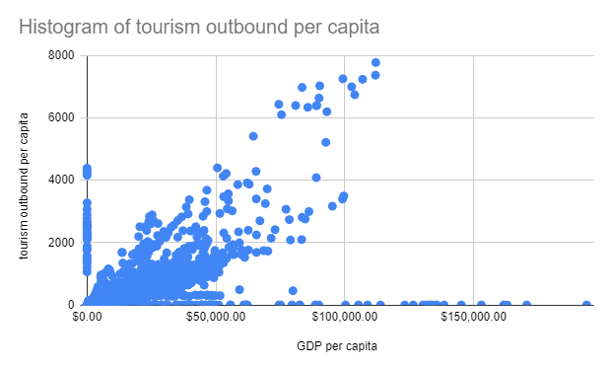
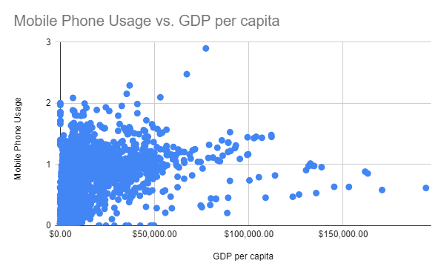
Health expenditure
Correlation factor : 0.7
Internet usage
Correlation factor : 0.7
Tourism outbound
Correlation factor : 0.6
Mobile phone usage
Correlation factor : 0.5

Slide 9
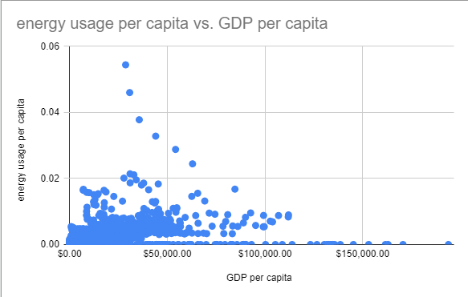
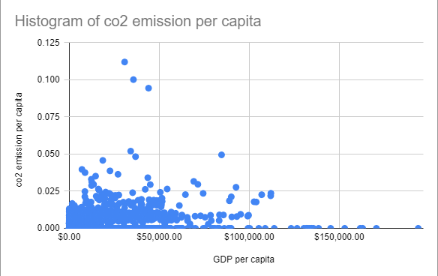
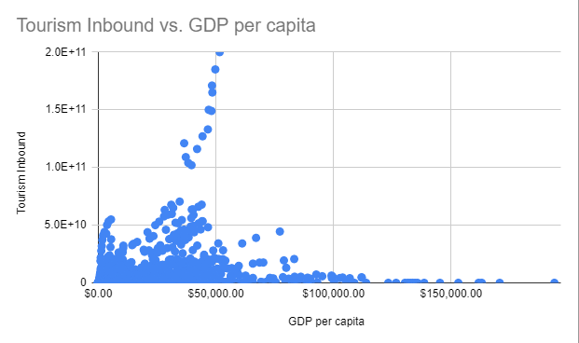
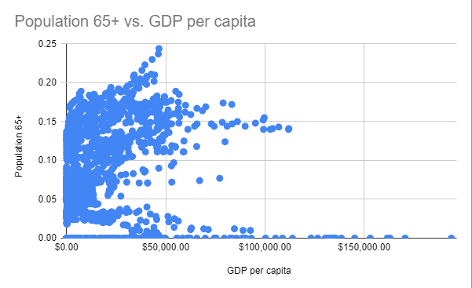
Energy usage
Correlation factor : 0.4
Carbon dioxide
Correlation factor : 0.3
Tourism inbound
Correlation factor : 0.3
Population 65+
Correlation factor : 0.3

Slide 10
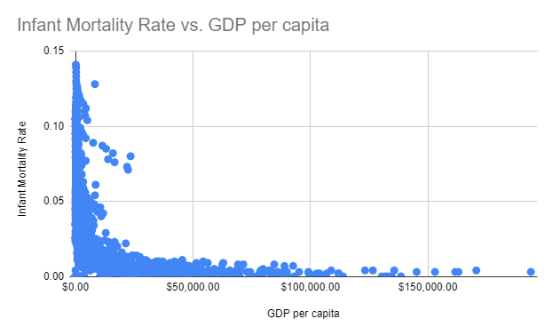
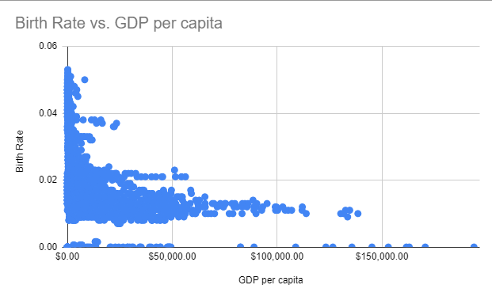
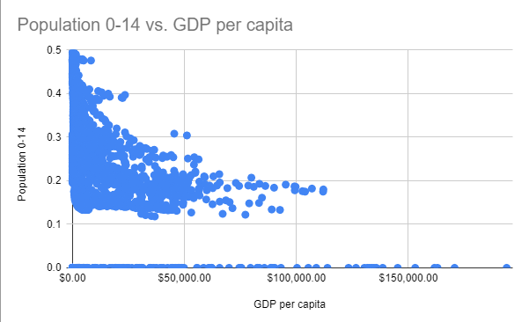
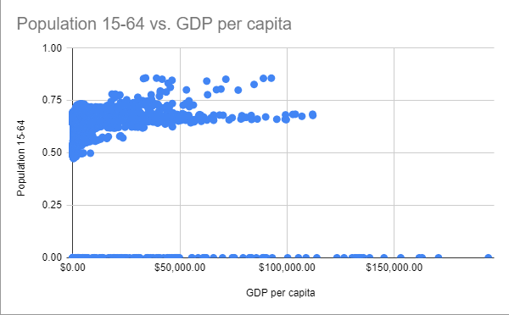
Infant mortality rate
Correlation factor : -0.4
Birth rate
Correlation factor : -0.4
Population 0-14
Correlation factor : -0.5
Population 15-64
Correlation factor : -0.1

Slide 11
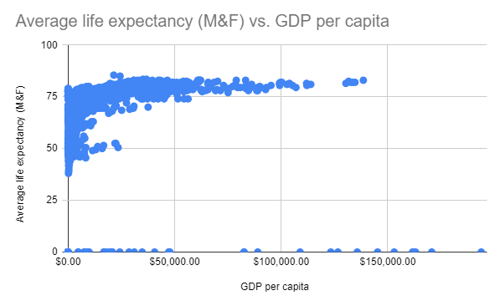
Life expectancy Average of male and female
Correlation factor : 0.2

